Slide 1
Providing Quality Legal Services to SCHOOL DISTRICTS Across Iowa
SCHOOL LAW: STAFF AND STUDENT ISSUES
Brett S. Nitzschke | Holly A. Corkery
Lynch Dallas, P.C.
July 17, 2015
Established 1926
Employee Evaluation, discipline, and termination
Student conduct and discipline
Discrimination, bullying, and harassment claims
Contract interpretation and administration
Building and construction matters
Special education matters
Policy formulation, revision, and implementation
Personnel policies and job descriptions
Negotiations and collective bargaining
Grievance and interest arbitrations
www.lynchdallas.com
bnitzschke@lynchdallas.com | hcorkery@lynchdallas.com
Twitter: @lynchdallaslaw
(319) 365-9101

Slide 2
What is social Media?
Established 1926
Can you identify these logos?

Slide 3
What is social Media?
Established 1926
Can you identify these logos?

Slide 4
What is social Media?
Established 1926
Facebook
3.1 million active users monthly
680 million mobile users
On average, people spend 18 minutes/visit on Facebook.
Twitter
Enables users to send and read other Twitter users’ messages (“Tweets”), however, messages are limited to 140 characters.
Over 289 active users.
58 million “tweets” are sent per day.

Slide 5
What is social Media?
Established 1926
Can you identify these logos?

Slide 6
What is social Media?
Established 1926
Can you identify these logos?

Slide 7
What is social Media?
Established 1926
Instagram
Photo and video sharing social media.
300 million active users
75 million daily users
55 million photos shared per day
Pinterest
After Facebook and Twitter, it’s the third most popular social networking site.
80% of Pinterest users are female.

Slide 8
What is social Media?
Established 1926
Can you identify these logos?

Slide 9
What is social Media?
Established 1926
Can you identify these logos?

Slide 10
What is social Media?
Established 1926
Snapchat
Photo sharing application
100 million users share 400 million “snaps” per day.
70% of all users are women.
Yik Yak
Yik Yak is an anonymous share application that allows users to post/read “Yaks” within a ten mile radius.
Users can “vote up” (like) or “vote down” dislike on different Yaks

Slide 11
What is social Media?
Established 1926
What’s coming?
Bubbly: Voice-based social media network. Users record messages to share on social media and can edit them with special effects.
Whisper: Social media network that allows users to share secrets anonymously. Secrets are organized into categories and searchable by keywords.
NOKNOK: An application that allows users to remain anonymous. The application allows the user to anonymously see how their contacts have saved them as a contact name. It also has an anonymous chat application.

Slide 12
What is social Media?
Established 1926
Why is Social Media Important to you?
Your students and employees are likely using it:
They are likely using it during school hours.
They are likely interacting with each other on it.
They may be mentioning/representing your District on it.
74% of all internet users are on social media.
71% of social media users are accessing from their mobile device (i.e. they’re always connected).
On average, U.S. citizens (as a whole, not just Facebook users), spend 16 minutes on Facebook per day.

Slide 13
Issues Arising on Social Media
Established 1926
Snap Chat & Yik Yak
Snap Chat
Snap chat is a texting application that allows users to send and receive photos that “self-destruct” in a few seconds.
Snap Chat and Child Porn Issues?
Recipients of snaps are able to get a screen shot of the photo and forward it to additional users
Issues arise when those photos are inappropriate and involve underage students
What to do? Call your attorney and/or law enforcement immediately.

Slide 14
Issues Arising on Social Media
Established 1926
Snap Chat & Yik Yak
Yik Yak
Yik Yak is not intended for those under 18. To keep high school students off Yik Yak, the application has created geo fencing around high schools to ensure that students cannot reach the application while at school.
If you think your high school is without the geo fencing contact Yik Yak at: www.yikyakapp.com/support
High school students are still accessing Yik Yak off school property though.

Slide 15
Issues Arising on Social Media
Established 1926
Snap Chat & Yik Yak
Yik Yak
The anonymity of Yik Yak makes it an easy resource for bullies
Examples of Yik Yaks that involve Iowa high school students:

Slide 16
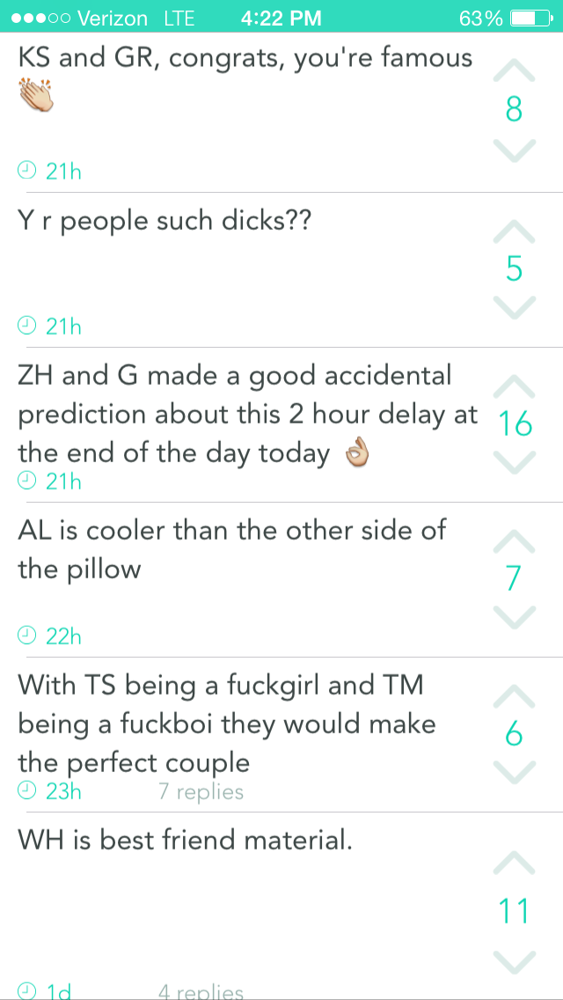
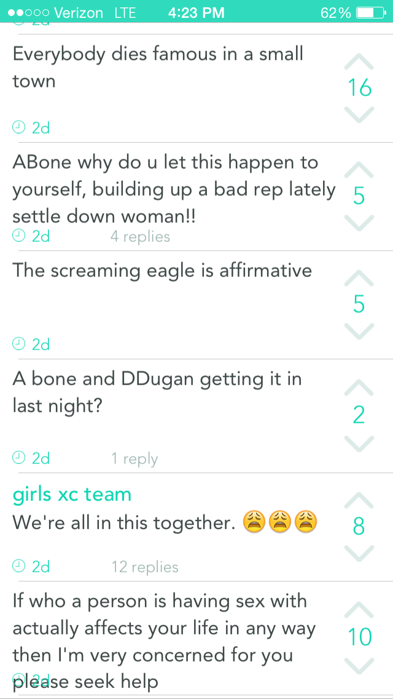
Issues Arising on Social Media
Established 1926
Snap Chat & Yik Yak

Slide 17
Issues Arising on Social Media
Established 1926
Impersonation Accounts
What do you do if your students are impersonating you, your co-workers, or each other?
Twitter: If the account discloses that it’s an impersonation (i.e., “Not the real Michael Jordan”), then Twitter will not do anything.
If they do not disclose that it’s an impersonation, then Twitter will work with you to take it down.

Slide 18
Issues Arising on Social Media
Established 1926
Impersonation Accounts
What do you do if your employees are impersonating you, your company, or each other?
Facebook: You can go to the impersonator’s timeline and file a report. Facebook has a specific impersonator option to deal with this situation.
Always remember that impersonator accounts exist when doing background checks.

Slide 19
Issues Arising on Social Media
Established 1926
Sexting
Twenty-four percent of high-school-aged students have sexted and thirty-three percent of college students have done so.
Typically, students are sexting their significant other, however ,15% of those who have sent a “sext” sent it to someone they did not know.

Slide 20
Issues Arising on Social Media
Established 1926
What do you do if you discover a
student is sexting?
Notify all parents of all students involved.
Contact the District’s Attorney and local police.
Student Discipline.

Slide 21
Regulating Expression on Social Media
Established 1926
When can students be disciplined for their conduct on social media?
When can employees be disciplined for their conduct on social media?

Slide 22
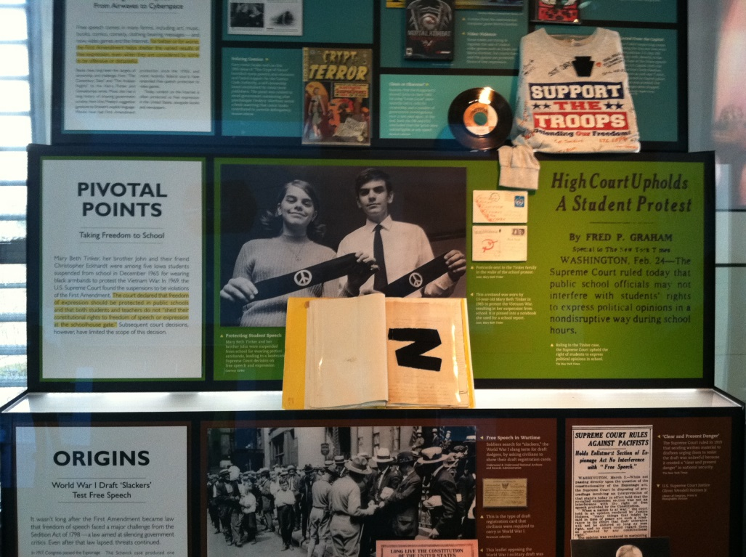
Regulating Expression on Social Media
Established 1926

Slide 23
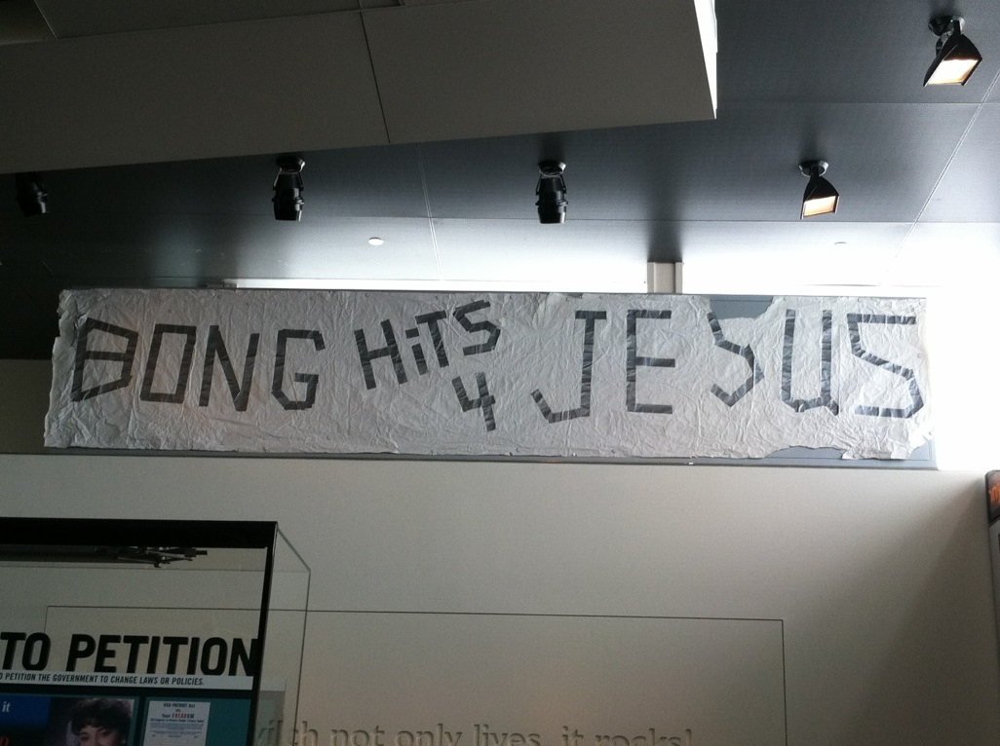
Regulating Expression on Social Media
Established 1926

Slide 24
Searching/Monitoring Technology
Established 1926
Searching a Student’s Wireless Device
First, try to get the student’s or his/her parents’ consent to search the phone.
If that is not successful, to conduct a valid search it must be:
Justified at its inception; and
Reasonable in scope.

Slide 25
Searching/Monitoring Technology
Established 1926
Searching an Employee’s Electronic Devices
Again, do not make this too hard. Try to obtain the employee’s consent before going any further.
If employee will not consent, does the employee have a reasonable expectation of privacy?

Slide 26
Searching/Monitoring Technology
Established 1926
Searching an Employee’s Electronic Devices
If no reasonable expectation of privacy, likely ok to proceed with the search.
If there is a reasonable expectation of privacy, must proceed with the “justified at its inception and reasonable in scope” analysis.

Slide 27
Searching/Monitoring Technology
Established 1926
Does your District have policies governing the use of the District’s Technology?
Acceptable Use Policies for District Technology, Network Systems Internet Access
Cell Phone Policies
How Your District’s Policies Affect Your Ability to Search/Monitor Technology

Slide 28
Searching/Monitoring Technology
Established 1926
Blanket E-mail Policies
In 2007, the NLRB ruled that blanket policies forbidding employees from using e-mail for personal use were permissible under Section 7.
The NLRB revisited the issue and overturned it (Purple Communications, Inc.).
“[E]mployee use of email for statutorily protected communications on nonworking time must presumptively be permitted by employers who have chosen to give employees access to their email system.”

Slide 29
Searching/Monitoring Technology
Established 1926
Public Records Issues
Public records are “all records, documents, tape, or other information, stored or preserved in any medium, of or belonging to . . . any . . . school corporation.” Iowa Code § 22.1 (3) (2014).
It is the nature and purpose of the document, not the place where it is kept, which determines its status as a public record.

Slide 30
Searching/Monitoring Technology
Established 1926
What do you do when employee conduct on their private accounts comes to your attention?
Community members are likely to have access to private accounts through “friending” and “following”;
What do you do when employee conduct on public accounts is not acceptable?

Slide 31
Searching/Monitoring Technology
Established 1926
Conduct that May Require Filing of a
BOEE Complaint
Dissemination and exhibition of obscene material to minors;
Telephone dissemination of obscene material to minors;
Sexual involvement or indecent contact with a student or minor;
Sexual exploitation of a student or minor;
Soliciting, encouraging, or consummating a romantic or otherwise inappropriate relationship with a student;
Furnishing alcohol or illegal or unauthorized drugs or drug paraphernalia to any student or knowingly allowing a student to consume alcohol or illegal or unauthorized drugs in the presence of the licensee.

